Slide 1
INTRODUCTION
TO
DATABASE MANAGEMENT SYSTEMS

Slide 2
Basic Definitions
Database: A collection of related data.
Data: Known facts that can be recorded and have an implicit meaning.
Mini-world: Some part of the real world about which data is stored in a database. For example, student grades and transcripts at a university.
Database Management System (DBMS): A software package/ system to facilitate the creation and maintenance of a computerized database.
Database System: The DBMS software together with the data itself. Sometimes, the applications are also included.

Slide 3
Definition
A DBMS is a software package for managing a database
A database is a collection of related data
Consistent: integrity constraints
Shared
  privacy, confidentiality
  Multiple user interfaces for different kinds of users
Example DBMSs: Oracle, DB2, Informix, Ingres, ….

Slide 4
Database Management System (DBMS)
DBMS contains information about a particular enterprise
  Collection of interrelated data
  Set of programs to access the data
  An environment that is both convenient and efficient to use
Database Applications:
  Banking: all transactions
  Airlines: reservations, schedules
  Universities: registration, grades
  Sales: customers, products, purchases
  Online retailers: order tracking, customized recommendations
  Manufacturing: production, inventory, orders, supply chain
  Human resources: employee records, salaries, tax deductions

Slide 5
Typical DBMS Functionality
Define a database : in terms of data types, structures and constraints
Construct or Load the Database on a secondary storage medium
Manipulating the database : querying, generating reports, insertions, deletions and modifications to its content
Concurrent Processing and Sharing by a set of users and programs – yet, keeping all data valid and consistent
Other features:
  Protection or Security measures to prevent unauthorized access
  “Active” processing to take internal actions on data
  Presentation and Visualization of data

Slide 6
Position of A DBMS Package
User
User
Kernel of
User
User
Bare
Hardware
OS
Operating System
User
DBMS
User
User

Slide 7
Position of A DBMS Package
A DBMS interacts with the Operating System
System resources: memory, processor, IO
File System
Security subsystem
and interfaces with Users
Database Administrators (DBA): designers, implementers,
maintainers
Database End-users: Casual or professional

Slide 8
Main Characteristics of the Database Approach
Self-describing nature of a database system: A DBMS catalog stores the description of the database. The description is called meta-data). This allows the DBMS software to work with different databases.
Insulation between programs and data: Called program-data independence. Allows changing data storage structures and operations without having to change the DBMS access programs.

Slide 9
Main Characteristics of the Database Approach
Data Abstraction: A data model is used to hide storage details and present the users with a conceptual view of the database.
Support of multiple views of the data: Each user may see a different view of the database, which describes only the data of interest to that user.

Slide 10
Main Characteristics of the Database Approach
Sharing of data and multiuser transaction processing : allowing a set of concurrent users to retrieve and to update the database. Concurrency control within the DBMS guarantees that each transaction is correctly executed or completely aborted. OLTP (Online Transaction Processing) is a major part of database applications.

Slide 11
Database Users
Users may be divided into those who actually use and control the content (called “Actors on the Scene”) and those who enable the database to be developed and the DBMS software to be designed and implemented (called “Workers Behind the Scene”).

Slide 12
Database Users- Actors on the scene
  Database administrators: responsible for
    Storage structure and access method definition
    authorizing access to the database,
    co-ordinating and monitoring its use,
    acquiring software and hardware resources,
    monitoring efficiency of operations.
    Backing up data
  Database Designers: responsible to define
    the content,
    the structure,
    the constraints,
    and functions or transactions against the database.
    They must communicate with the end-users and understand their needs.

Slide 13
Categories of End-users
  End-users: they use the data for queries, reports and some of them actually update the database content.
Casual : access database occasionally when needed
Naïve or Parametric : they make up a large section of the end-user population. They use previously well-defined functions in the form of “canned transactions” against the database. Examples are bank-tellers or reservation clerks who do this activity for an entire shift of operations.

Slide 14
Categories of End-users
Sophisticated : these include business analysts, scientists, engineers, others thoroughly familiar with the system capabilities. Many use tools in the form of software packages that work closely with the stored database.
Stand-alone : mostly maintain personal databases using ready-to-use packaged applications. An example is a tax program user that creates his or her own internal database.

Slide 15
Data Bases
Remove redundancy: centralize all data, represent in exactly one place
Provide global logical view
Separate logical view from physical to allow customized logical views
Enable sharing: all applications may run concurrently
A data base is a central pool of data sharable among its many users
loss of individual control of data
response times in accordance with organisation needs

Slide 16
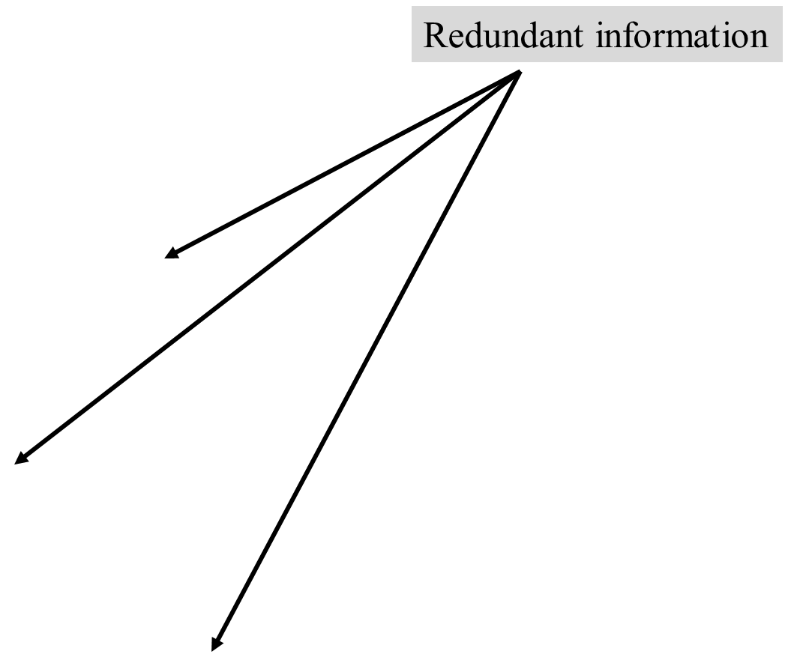
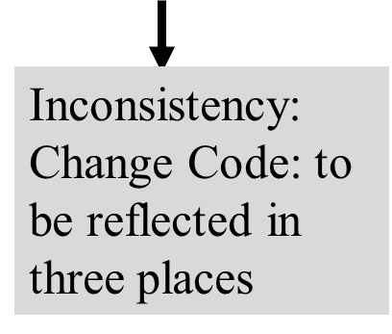
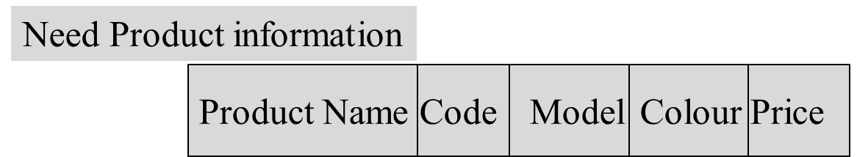
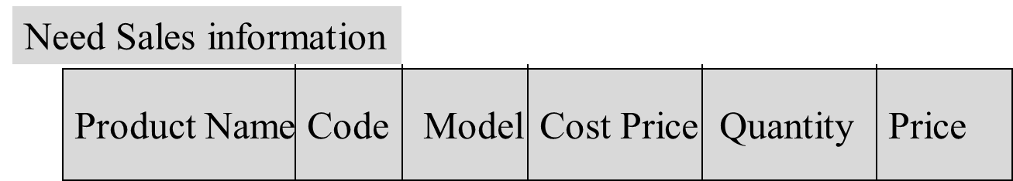
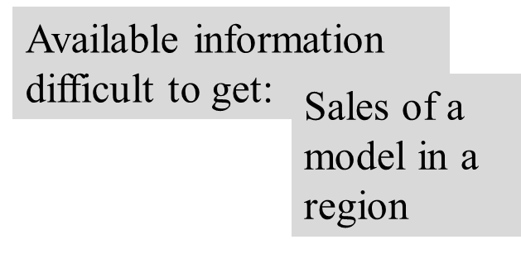
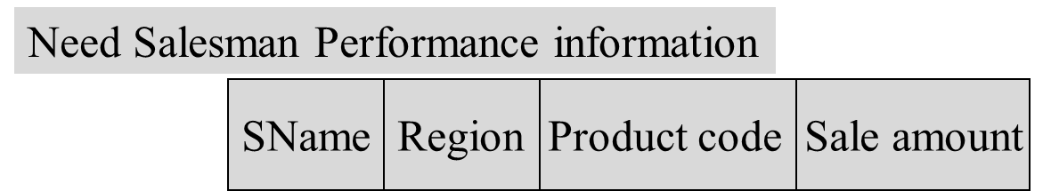
File Systems
Applications are developed ‘on the fly’

Slide 17
File Systems
Data representation
Each file has its own logical format
File organisation varies with applications
Programs
access files in accordance with their access methods
and logical format
new format implies creating new file & accessing existing ones

Slide 18
Purpose of Database Systems
In the early days, database applications were built directly on top of file systems
Drawbacks of using file systems to store data:
  Data redundancy and inconsistency
    Multiple file formats, duplication of information in different files
  Difficulty in accessing data
    Need to write a new program to carry out each new task
  Data isolation — multiple files and formats
  Integrity problems
    Integrity constraints (e.g. account balance > 0) become “buried” in program code rather than being stated explicitly
    Hard to add new constraints or change existing ones

Slide 19
Drawbacks of using file systems (cont.)
  Atomicity of updates
    Failures may leave database in an inconsistent state with partial updates carried out
    Example: Transfer of funds from one account to another should either complete or not happen at all
  Concurrent access by multiple users
    Concurrent accessed needed for performance
    Uncontrolled concurrent accesses can lead to inconsistencies
      Example: Two people reading a balance and updating it at the same time
  Security problems
    Hard to provide user access to some, but not all, data
Database systems offer solutions to all the above problems

Slide 20
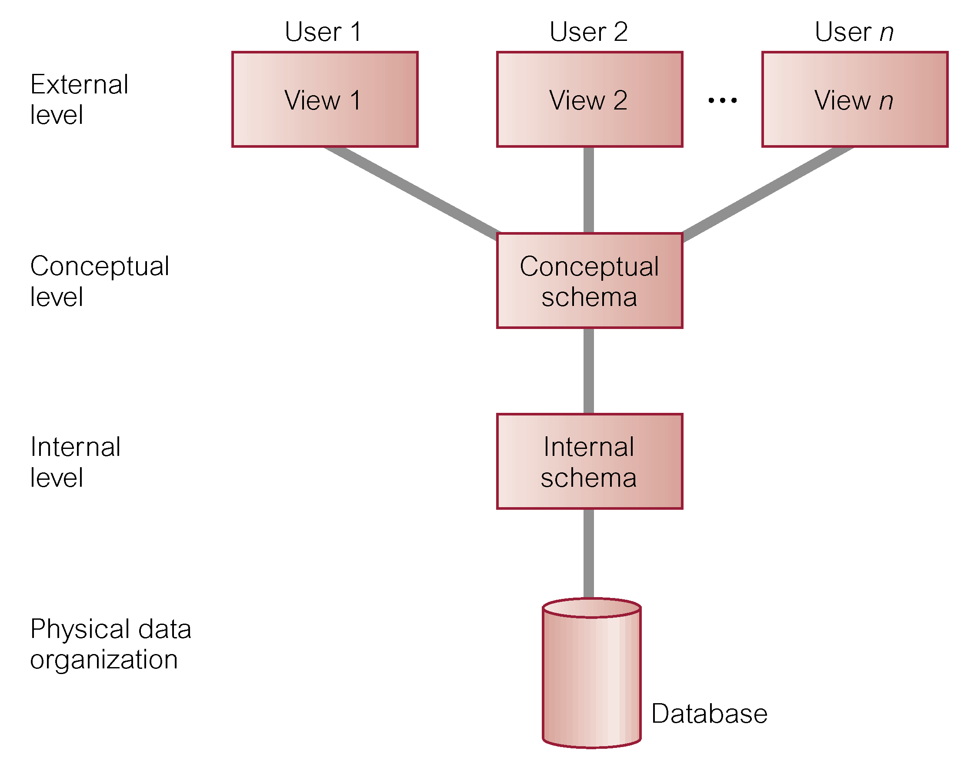
ANSI-SPARC
Three-Level Architecture

Slide 21
Three-Schema Architecture
Defines DBMS schemas at three levels:
  Internal schema at the internal level to describe physical storage structures and access paths. Typically uses a physical data model.
  Conceptual schema at the conceptual level to describe the structure and constraints for the whole database for a community of users. Uses a conceptual or an implementation data model.
  External schemas at the external level to describe the various user views. Usually uses the same data model as the conceptual level.

Slide 22
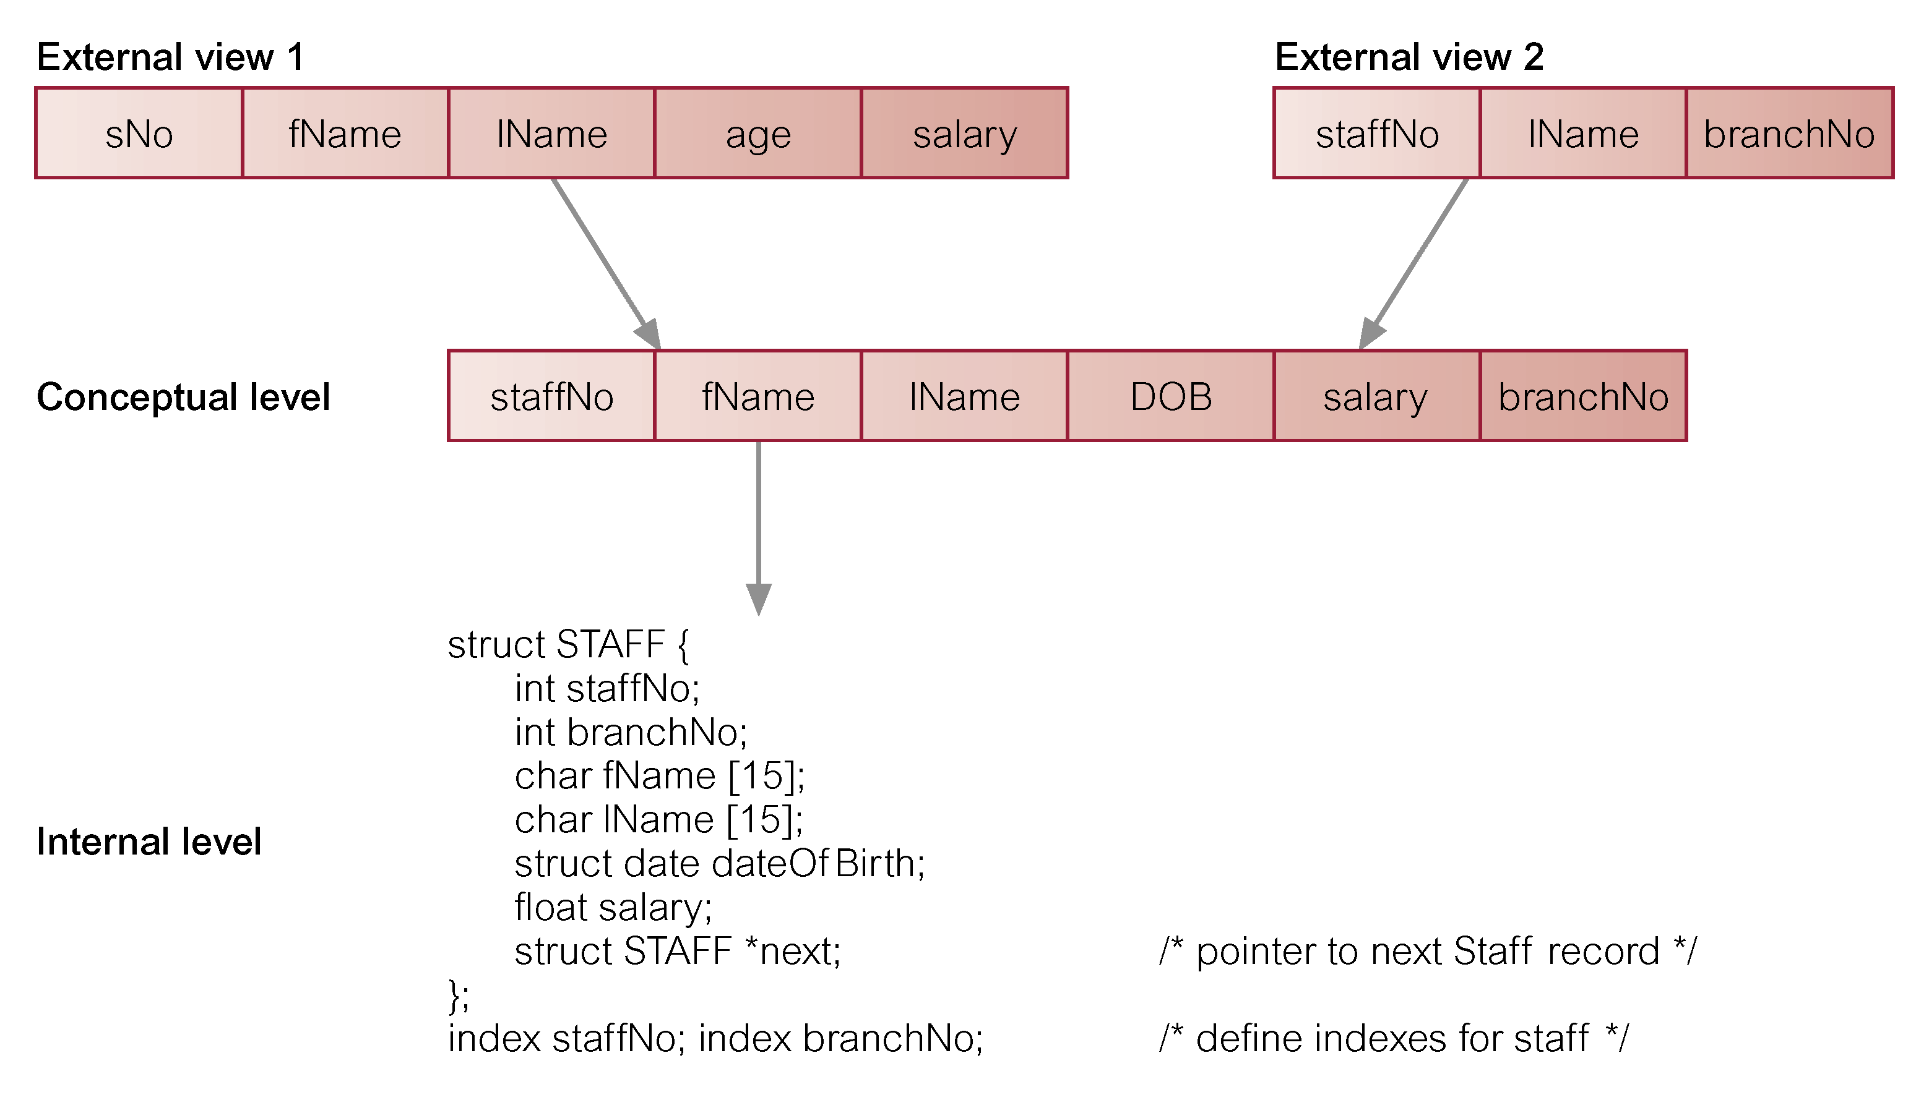
Differences between Three Levels of ANSI-SPARC Architecture

Slide 23
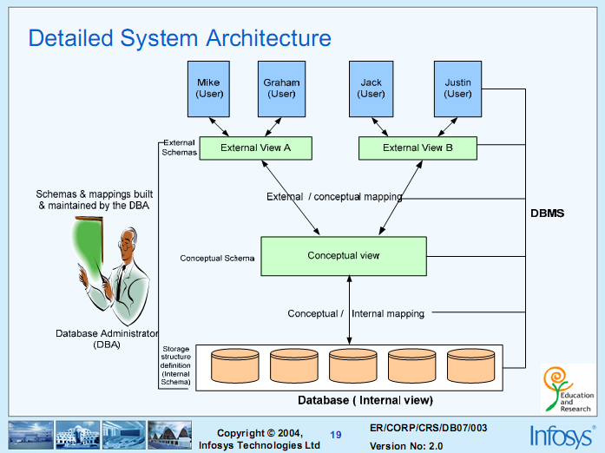
ANSI/SPARC (American National Standards Institute/Standard Planning and Requirements Committee) Model

Slide 24
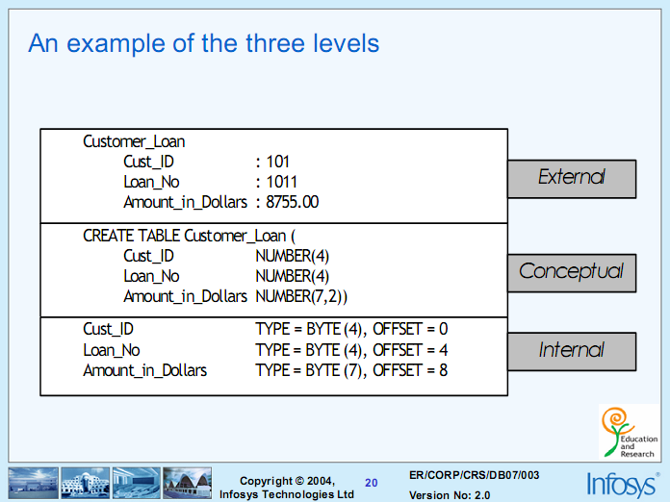

Slide 25
Data Independence
When a schema at a lower level is changed, only the mappings between this schema and higher-level schemas need to be changed in a DBMS that fully supports data independence.
The higher-level schemas themselves are unchanged.
Hence, the application programs need not be changed since they refer to the external schemas.
This is called data independence.

Slide 26
Data Independence
Physical Data Independence – the ability to modify the physical schema without changing the logical schema (and the external schema as well)
  Physical schema may change because of storage structure or access strategy to improve performance of retrieval or update
Logical Data Independence – the ability to modify the logical schema without changing the external schemas or the application program.
  Logical schema may change due to expansion in database, changing constraints or to reduce the database.
  Only the external/conceptual(logical) and conceptual/internal mapping need be changed in a DBMS to support data independence.

Slide 27
Abstraction & Levels of Abstraction
Abstraction: hiding details from users
Three levels (depending on what is hided from user):
Physical level: describes how a record (e.g., customer) is stored.
Logical level: describes data stored in database, and the relationships among the data.
  type customer = record
  customer_id : string;
  customer_name : string;
  customer_street : string;
  customer_city : string;
        end;
View level: application programs hide details of data types. Views can also hide information (such as an employee’s salary) for security purposes.

Slide 28
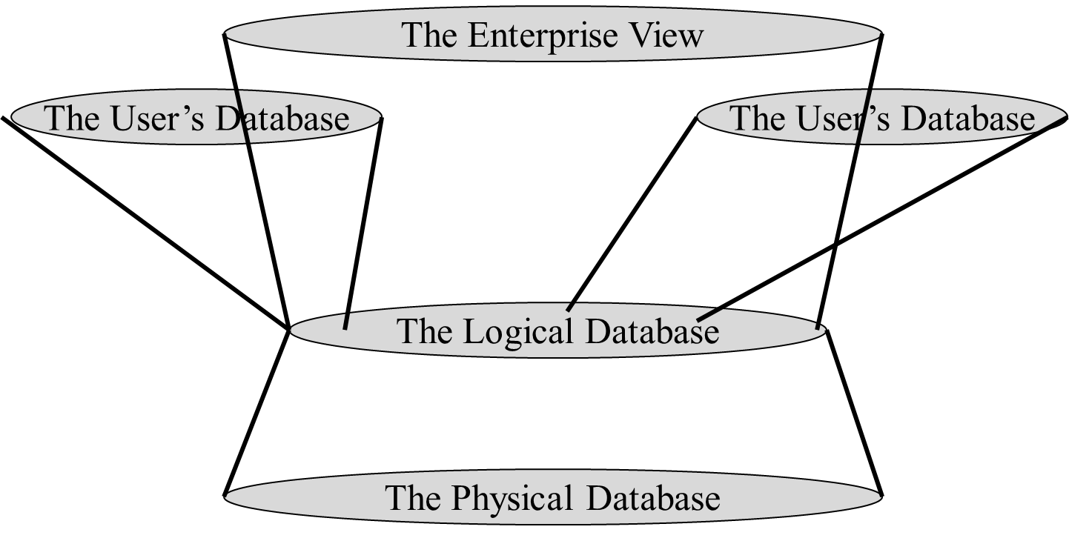
Data Base Views

Slide 29
Instances and Schemas
Similar to types and variables in programming languages
Schema – the logical structure of the database
  Example: The database consists of information about a set of customers and accounts and the relationship between them)
  Analogous to type information of a variable in a program
  Physical schema: database design at the physical level
  Logical schema: database design at the logical level
Instance – the actual content of the database at a particular point in time
  Analogous to the value of a variable

Slide 30
Data Manipulation Language (DML)
Language for accessing and manipulating the data organized by the appropriate data model
  DML also known as query language
Another Two classes of languages
  Procedural – user specifies what data is required and how to get those data eg. Relational algebra
  Declarative (non procedural) – user specifies what data is required without specifying how to get those data
SQL is the most widely used query language (non procedural)

Slide 31
Data Definition Language (DDL)
Specification notation for defining the database schema
  Example: create table account (
  account_number char(10),
  branch_name char(10),
  balance integer)
DDL compiler generates a set of tables stored in a data dictionary
Data dictionary contains metadata (i.e., data about data)
  Database schema
  Uses Data storage and definition language
    Specifies the storage structure and access methods used
  Integrity constraints
    Domain constraints
    Referential integrity (e.g. branch_name must correspond to a valid branch in the branch table)
  Authorization

Slide 32
Data Models
A data model comprises of three components:
• A structural part, consisting of a set of rules according to which databases can be constructed.
• A manipulative part, defining the types of operation that are allowed on the data (this includes the operations that are used for updating or retrieving data from the database and for changing the structure of the database).
• Possibly a set of integrity rules, which ensures that the data is accurate.

Slide 33
Data Models
A collection of tools for describing
  Data
  Data relationships
  Data semantics
  Data constraints
Types of database models
Record based data models
  Relational model
  Network model
  Hierarchical model
Object-based data models
  Entity-Relationship data model (mainly for database design)
  Object-oriented data model

Slide 34
Types of database models
Object-based logical models
  Are used to describe data at the conceptual and view level.
  Use concepts such as entities, attributes, objects and relationships.
    Entity-Relationship model
    Object-oriented model
Record-based logical models
  Are used to describe data at the conceptual and view level.
  Are used to specify the overall logical structure of the database and to provide a higher-level description of the implementation.
  Use record structure for storing data
    Network model
    Hierarchical model
    Relational model.

Slide 35
Types of database models
Physical data models
    Are used to describe data at the physical level (bytes and words).
    It mainly deals with hardware.
    It describe how data is stored in the computer, representing information such as record structures, record ordering, and access paths.

Slide 36
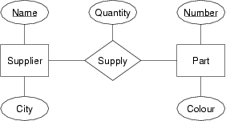
The Entity-Relationship Model
Models an enterprise as a collection of entities and relationships
  Entity: a “thing” or “object” in the enterprise that is distinguishable from other objects
    Described by a set of attributes
  Relationship: an association among several entities
Represented diagrammatically by an entity-relationship diagram:

